Slide 1
AI OpenScale Lab IBM Watson & Cloud Platform — Eric Martens Anthony Stevens Owais Hashmi New Orleans, Jan 22 Madrid, Jan 29 Singapore, Feb 26

Slide 2
Legal Disclaimer
© IBM Corporation 2018. All Rights Reserved.
The information contained in this publication is provided for informational purposes only. While efforts were made to verify the completeness and accuracy of the information contained in this publication, it is provided AS IS without warranty of any kind, express or implied. In addition, this information is based on IBM’s current product plans and strategy, which are subject to change by IBM without notice. IBM shall not be responsible for any damages arising out of the use of, or otherwise related to, this publication or any other materials. Nothing contained in this publication is intended to, nor shall have the effect of, creating any warranties or representations from IBM or its suppliers or licensors, or altering the terms and conditions of the applicable license agreement governing the use of IBM software.
References in this presentation to IBM products, programs, or services do not imply that they will be available in all countries in which IBM operates. Product release dates and/or capabilities referenced in this presentation may change at any time at IBM’s sole discretion based on market opportunities or other factors, and are not intended to be a commitment to future product or feature availability in any way. Nothing contained in these materials is intended to, nor shall have the effect of, stating or implying that any activities undertaken by you will result in any specific sales, revenue growth or other results.
Performance is based on measurements and projections using standard IBM benchmarks in a controlled environment. The actual throughput or performance that any user will experience will vary depending upon many factors, including considerations such as the amount of multiprogramming in the user's job stream, the I/O configuration, the storage configuration, and the workload processed. Therefore, no assurance can be given that an individual user will achieve results similar to those stated here.
All customer examples described are presented as illustrations of how those customers have used IBM products and the results they may have achieved. Actual environmental costs and performance characteristics may vary by customer.
All references to fictitious companies are used for illustration purposes only.

Slide 3

Download these:
Instructions: https://goo.gl/CzAGrW
PPT: https://goo.gl/7s1Rng
Notes:
Notebook: https://goo.gl/7qvuHc

Slide 4

So what are we going to accomplish in this lab?
prediction requests
data mart in DB2
payload
Watson Machine Learning
feedback
training data
AI OpenScale
derived statistics
accuracy
bias
prediction rate
custom metrics
…
Notes:
Today we are announcing a critical capability most organizations do NOT have today
Clarity and visibility into how organizations AI is built, run and managed in production deployments.
AI OpenScale will major on operations around AI with trust & transparency leveraging the most common open frameworks and runtimes.
https://console.bluemix.net/catalog/services/ai-openscale

Slide 5
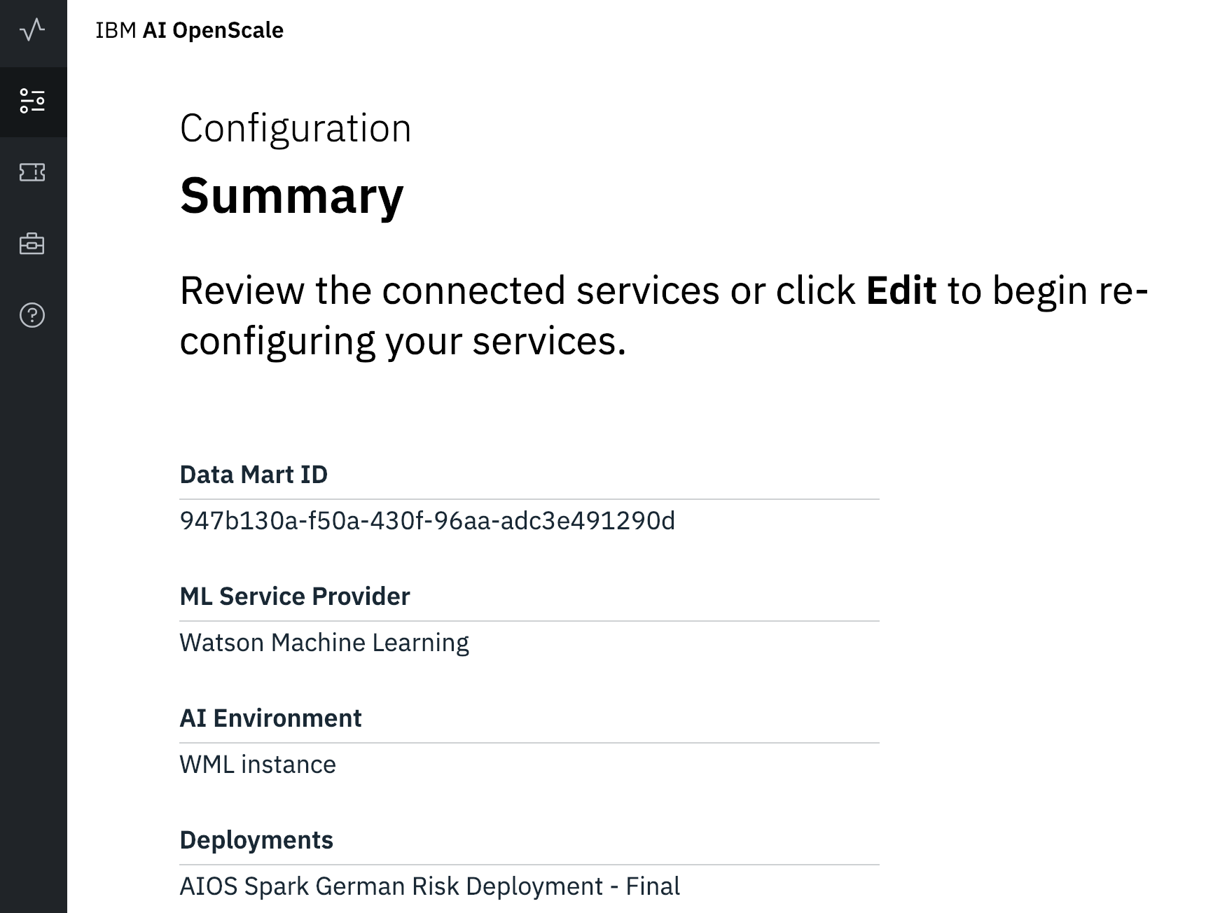
Notebook initializes AI OpenScale
Model trained
Model deployed
Prediction tracing
Monitors enabled
Fairness
Accuracy
Throughput
Load historic data

Slide 6
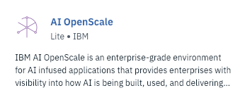
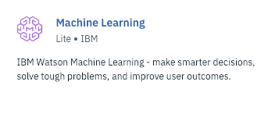
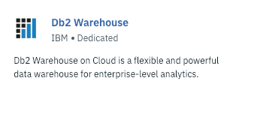
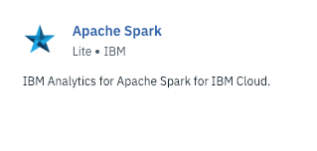
Three services required to execute the notebook
prediction payloads and training data stored here
machine learning models stored here

Slide 7
INCREASE
LOANS
loan
REDUCE
RISK
credit lender
loan applicants
lender’s data
RISK
MODEL
3rd party data
data science
team
Notes:
To understand how AI OpenScale bring trust and transparency to machine learning models, let’s explore the challenges facing a consumer credit lender that wants to expand their services to a larger group of people. As many of these people may not have standard credit histories, the lender has to take in larger and more varied data sources. To make sense of all this complicated data, they can’t rely on traditional analytics approach and must resort to advanced machine learning algorithms.

Slide 8
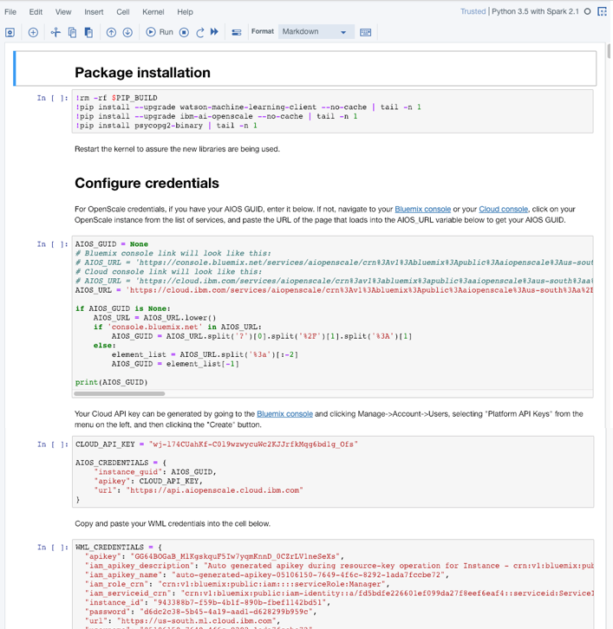
Follow the guide to setup your notebook
The notebook executes in under 5 mins on a free spark environment

Slide 9
Let’s put hands on keyboards
Raise your hand if you have questions
If you didn’t get the file download links then ask your neighbor

Slide 10

Dataset: Credit Risk
UC Irvine (UCI) provides a labeled training dataset of 1,000 people that are classified as good or bad credit risks
Dataset contains 20 attributes about loan applicants:
Credit history Status of existing checking account Duration of requested loan Purpose of loan Loan amount Existing savings account/bonds Present employment since (years) Installment rate as % of disposable income Personal status and sex (e.g. married female) Other debtors / guarantors on loan | Present residence since (years) Property owned Age in years Other existing credit lines Housing Number of existing credits at this bank Job Number of dependents Telephone Is a foreign worker
Age and sex attributes allow bias can be evaluated
Data set was expanded to 25,000 rows using synthetic data techniques
Details in this box note: https://ibm.box.com/s/x1h7jznot90f8pfqsn2mvjf0zytmk85m

Slide 11
Prediction Feed Notebook:
https://goo.gl/NW7Kwj
Schedule this notebook to run every hour using Watson Studio

Slide 12
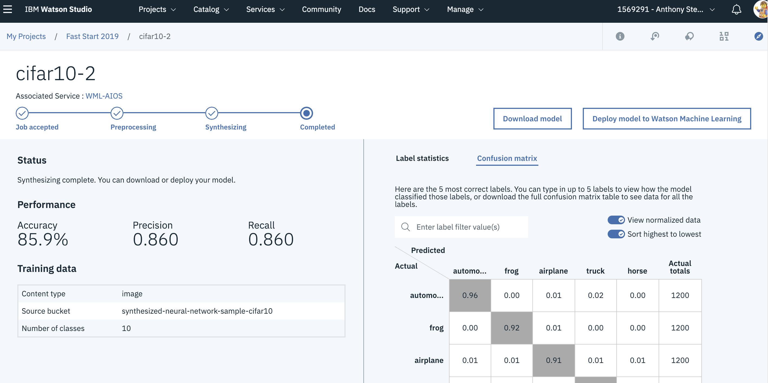
AI for AI Neural Network Synthesis: NeuNetS
reformat
Neural Architecture Search (NAS)
Starting from a small base network, NeuNetS evaluates performance then evolves and search for the optimal network for the given dataset.
NeuNetS is a fundamentally new AI system technique for Neural Network design that automatically designs a new neural network or evolves a neural network architecture from existing ones.
evaluate and evolve
Iteration N
Iteration N+1
© IBM Corporation
IBM Confidential
Notes:
Meta-Model
Coarse grain synthesis – build the skeleton of the house (model that is built that learns from all NN that exist – 500X and learns the internal features of the model and when there is new data will start defining the layers based on the combination of what it sees before – student and teacher; AI model that learns from other AI model and with new data
Fine grain synthesis – fine grain synthesis – do we need details on the tuning

Slide 13
Installing AIOS on ICP
Instructions:
HTML
Powerpoint slide deck

Slide 14


